Slide 1

INTRODUCTION TO NON MONOTONIC REASONING LECTURE 3: MODAL LOGICS
Computer Science Department
University of Verona - Italy

Slide 2
TODAY’S LECTURE
UNIT 3: MODAL LOGIC AND NON MONOTONIC PARADIGM
Labelled and modal logics
Introduction to labelled logics
Modal logics
Specific non monotonic modal structures
Epistemic logic
BDI systems (Beliefs, Desires, Intentions)
Temporal reasoning and non-monotonicity
Linear logic is non-monotonic
Representing learning and forgetting
Belief revision

Slide 3
LABELLED LOGICS
A labelled logic is a logic in which a formula can be preceded by a label
Abstractly, propositional single labelling could be the basic to start with

Slide 4
TYPING AND MOVING AROUND
It is strongly dependent on the meaning of the labels
It is depending on the interpretation of the label structure, if any

Slide 5
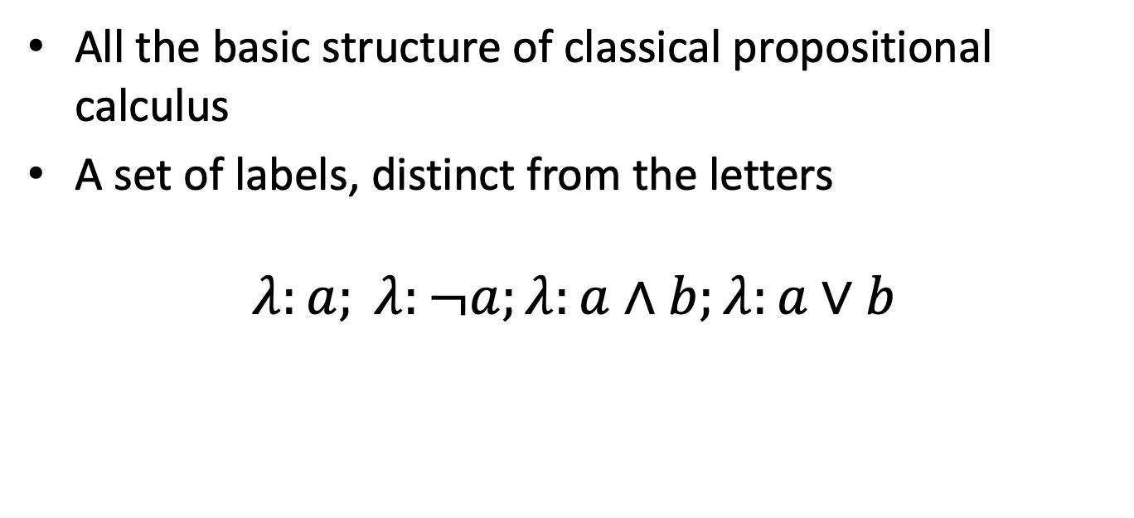
PROPOSITIONAL MODEL
All the basic structure of classical propositional calculus
A set of labels, distinct from the letters
$$λ:a; λ:¬a;λ:a∧b;λ:a∨b$$

Slide 6
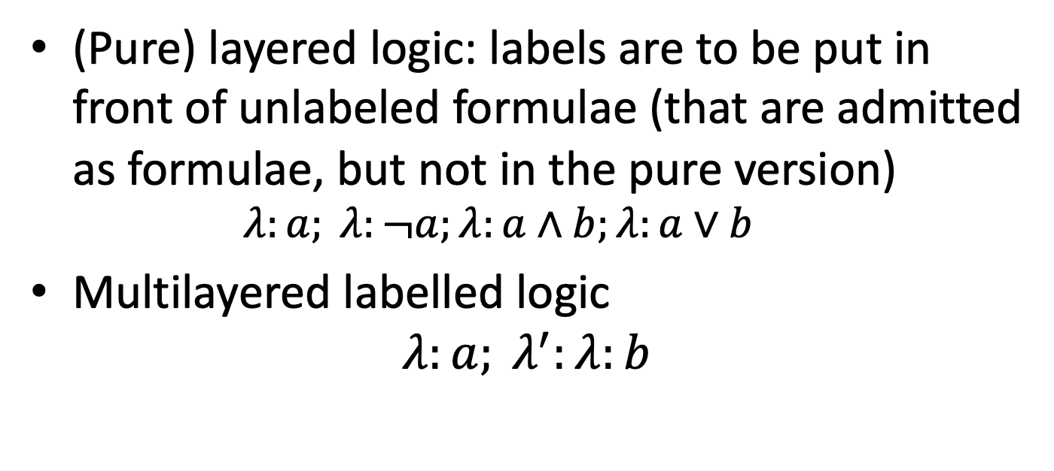
VARIANTS
(Pure) layered logic: labels are to be put in front of unlabeled formulae (that are admitted as formulae, but not in the pure version)
$$λ:a; λ:¬a;λ:a∧b;λ:a∨b$$
Multilayered labelled logic
$$λ:a; λ^{′}:λ:b$$

Slide 7
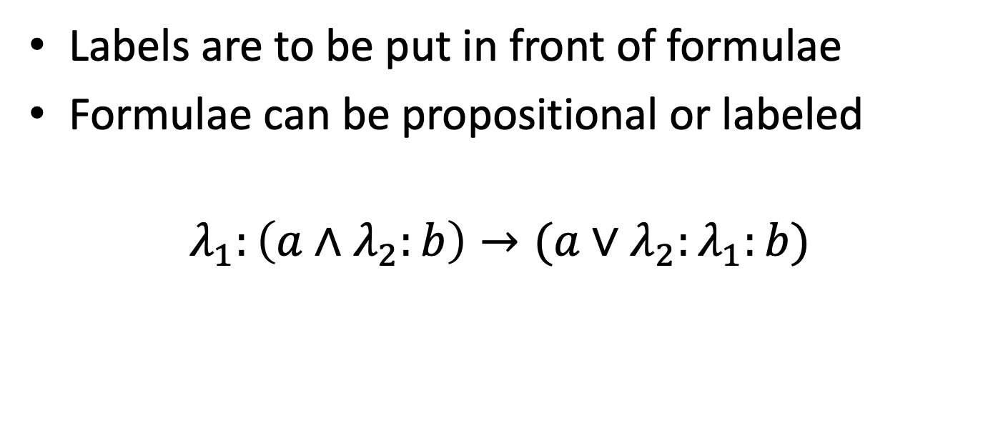
FULL LABELED LOGIC
Labels are to be put in front of formulae
Formulae can be propositional or labeled
$$λ_{1}:\left(a∧λ_{2}:b\right)→(a∨λ_{2}:λ_{1}:b)$$

Slide 8
GENERAL ISSUES IN LABELLED LOGIC
Propositional meaning
Label elimination
Relations on labels
Operations on labels

Slide 9
PROPOSITIONAL ATOMS
Every atom of a labelled propositional logic
Atoms can be obtained by rewriting formulae and rewriting labels
Label rewriting is the core business

Slide 10
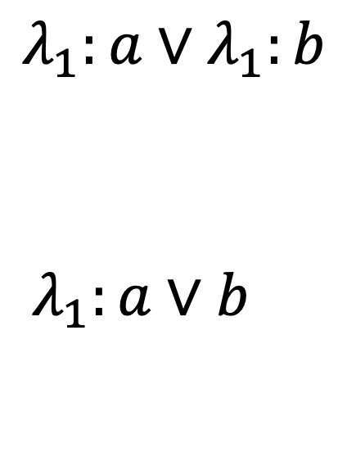
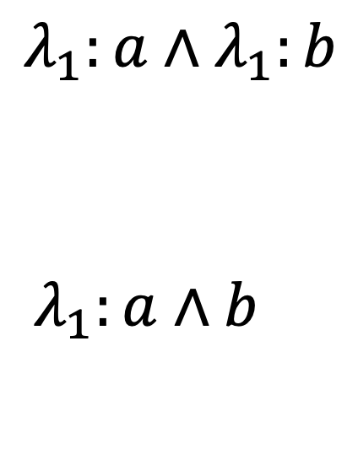
BOOLEAN REWRITING
$$λ_{1}:a{∧λ}_{1}:b$$
$$λ_{1}:a∧b$$
$$λ_{1}:a{∨λ}_{1}:b$$
$$λ_{1}:a∨b$$

Slide 11
MODAL LOGICS
The knowledge and time paradox
The nonmonotonic nature of knowledge: learning and forgetting
Some issues in deontic logic

Slide 12
The Muddy Children Puzzle
n children meet their father after playing in the mud. The father notices that k of the children have mud dots on their foreheads.
Each child sees everybody else’s foreheads, but not his own.
The father says: “At least one of you has mud on his forehead.”
The father then says: “Do any of you know that you have mud on your forehead? If you do, raise your hand now.”
No one raises his hand.
The father repeats the question, and again no one moves.
After exactly k repetitions, all children with muddy foreheads raise their hands simultaneously.

Slide 13

Muddy Children (cont.)
Suppose k = 1
The muddy child knows the others are clean
When the father says at least one is muddy, he concludes that it’s him

Slide 14
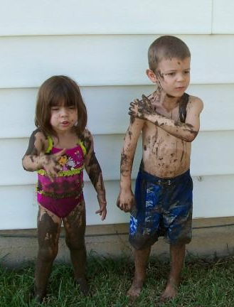
Muddy Children (cont.)
Suppose k = 2
Suppose you are muddy
After the first announcement, you see another muddy child, so you think perhaps he’s the only muddy one.
But you note that this child did not raise his hand, and you realise you are also muddy.
So you raise your hand in the next round, and so does the other muddy child

Slide 15
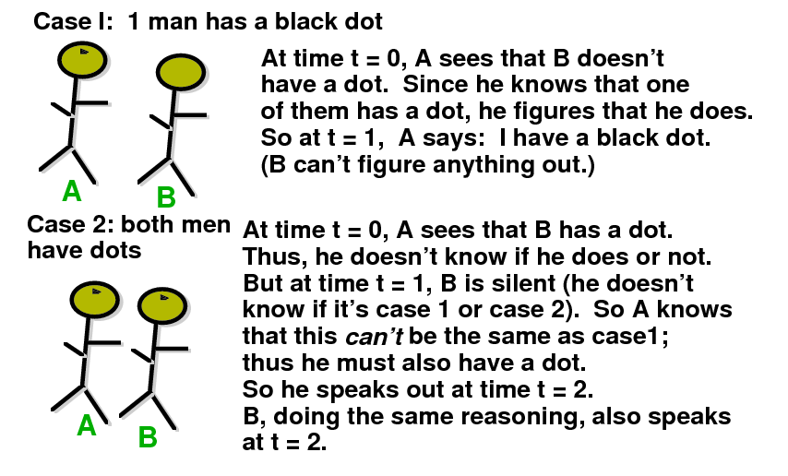
Muddy Children.
Detailed analysis of two children

Slide 16
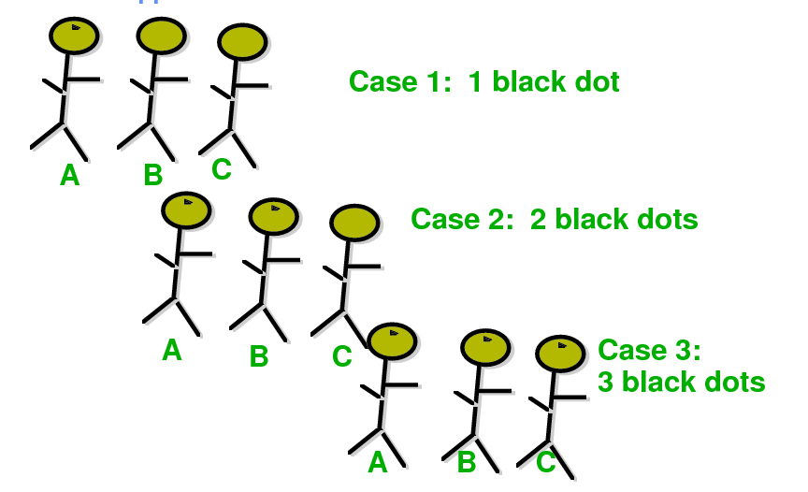
Muddy Children.
Now suppose there are 3 children

Slide 17
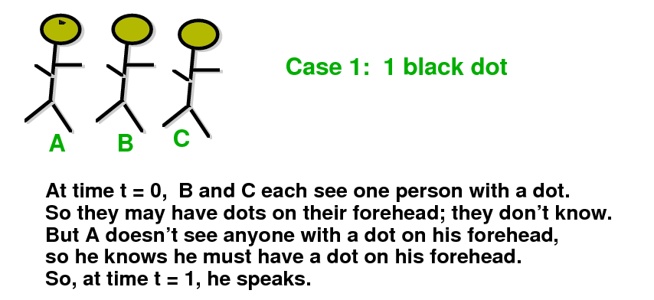
Muddy Children.
Case of three children

Slide 18
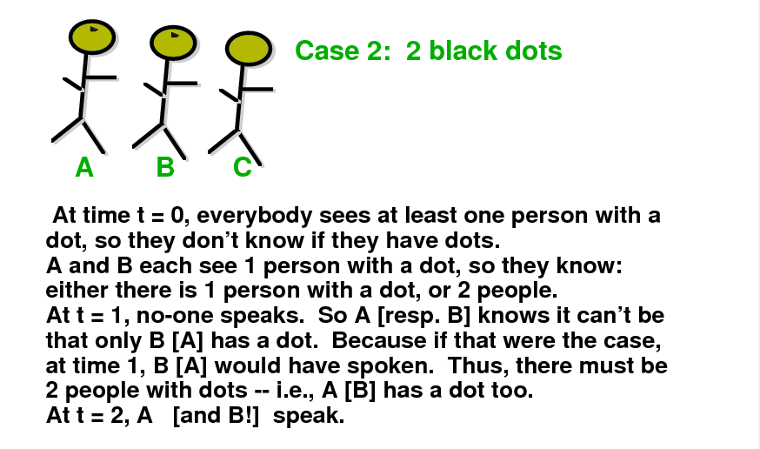
Muddy Children.
Case of three children

Slide 19
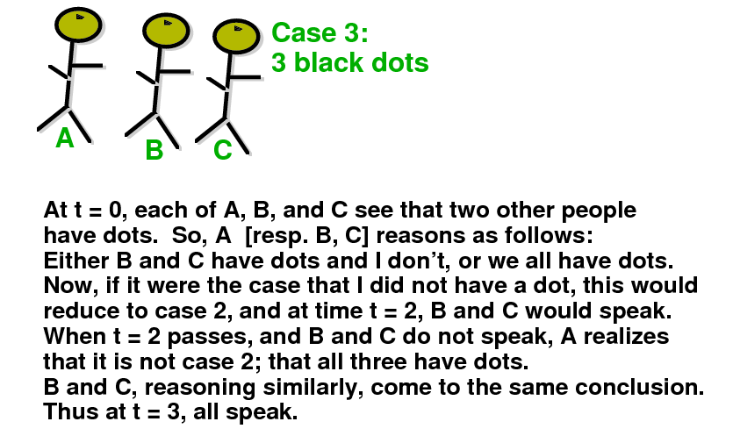
Muddy Children.
Case of three children

Slide 20
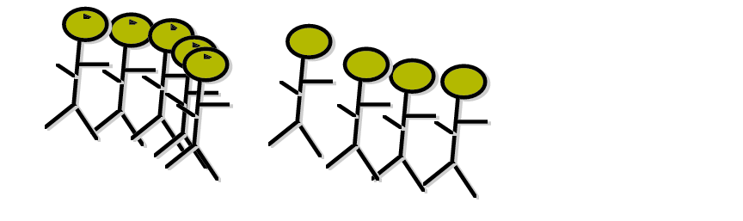
Muddy Children.
Case of N children
Theorem
K children will speak at time t=K
The crucial concepts:
Common knkowledge
Consequential closure
Assume N children
Assume K have mud on heads.
Assuming – common knowledge of at least one dot ,
all perfect reasoners
each round of reasoning takes one unit
This is the simplest problem that can be solved using modal logic and its variants

Slide 21
The Partition Model of Knowledge

Slide 22
Concepts to remind from classical logic
Agent
Group of agents
Language
Ordered tuple for definition
Possible worlds
Interpretation function
Partitions of set

Slide 23
Worlds and non-distinguishability of worlds
Suppose there are two propositions p and q
There are 4 possible worlds:
w₁: p ∧ q
w₂: p ∧ ¬ q
w₃: ¬ p ∧ q
w₄: ¬ p ∧ ¬ q
Suppose the real world is w₁, and that in w₁ agent i cannot distinguish between w₁ and w₂
We say that I_{i}(w₁) = {w₁, w₂}
This means, in world w₁ agent i cannot distinguish between world w₁ and world w₂
W = {w₁ , w₂ , w₃ , w₄ } is the set of all worlds
Function I describes non-distinguishability of worlds

Slide 24
Partition Model of knowledge, partition of worlds in the set of all worlds W
What is partition of worlds?
Each I_{i} is a partition of W for agent i
Remember: a partition chops a set into disjoint sets
I_{i}(w) includes all the worlds in the partition of world w
Intuition:
if the actual world is w, then I_{i}(w) is the set of worlds that agent i cannot distinguish from w
i.e. all worlds in I_{i}(w), all possible as far as i knows

Slide 25
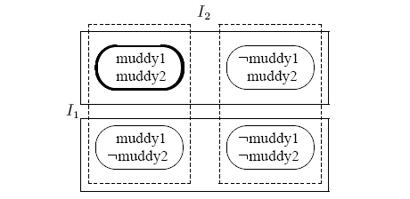
W = set of all worlds for Muddy Children with two children
This is knowledge of child 2
w₂
w₁
w₄
w₃
Partition model when children see one another but before father speaks

Slide 26
The Partition Model of Knowledge
Now we can define the partition model of Knowledge
An n-agent partition model over language Σ is A = (W, π, I₁, …, I_{n}) where
W is a set of possible worlds
π : Σ → 2^{W} is an interpretation function that determines which sentences are true in which worlds
Each I_{i} is a partition of W for agent i
Remember: a partition chops a set into disjoint sets
I_{i}(w) includes all the worlds in the partition of world w

Slide 27
The Knowledge Operator
By K_{i}ϕ we will denote that:
“agent i knows that ϕ”
It describes the knowledge of an agent

Slide 28
Logical Entailment
What is logical entailment?
Let us recall definition:
We say A,w |= K_{i}ϕ if and only if ∀w’,
if w’∈I_{i}(w), then A,w |= ϕ
Intuition: in partition model A, if the actual world is w, agent i knows ϕ if and only if ϕ is true in all worlds he cannot distinguish from w

Slide 29
The Knowledge Operator
By K_{i}ϕ we will denote that:
“agent i knows that ϕ”
Let A = (W, π, I₁, …, I_{n}) be a partition model over language Σ and let w ∈ W
We define logical entailment |= as follows:
For ϕ ∈ Σ we say (A,w |= ϕ) if and only if w ∈ π(ϕ)
We say A,w |= K_{i}ϕ if and only if ∀w’,
if w’∈I_{i}(w), then A,w |= ϕ
π : Σ → 2^{W} is an interpretation function

Slide 30
Modal Logic

Slide 31
Modal Logic: basic operators
Can be built on top of any language
Has several special variants related to sub-domains
Two modal operators:
ϕ reads “ϕ is necessarily true”
◊ϕ reads “ϕ is possibly true”
Equivalence:
◊ϕ ≡ ¬¬ϕ
ϕ ≡ ¬◊¬ϕ
So we can use only one of the two operators, for instance “necessary”
But it is more convenient to use two operators.
Next we will be using even more than two, but the understanding of these two is crucial.

Slide 32
Modal Logic: Syntax
Let P be a set of propositional symbols
We define modal language L as follows:
If p ∈ P and ϕ, ψ ∈ L then:
p ∈ L
¬ϕ ∈ L
ϕ ∧ ψ ∈ L
ϕ ∈ L
Remember that ◊ϕ ≡ ¬¬ϕ, and ϕ ∨ψ ≡ ¬ (¬ϕ ∧¬ψ) and ϕ →ψ ≡ ¬ϕ ∨ ψ
We can extend the language defining new symbols of operators

Slide 33
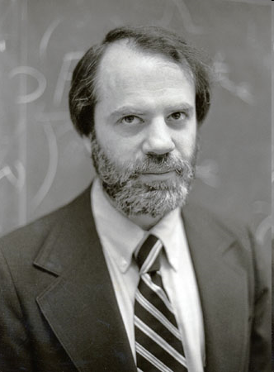
Modal Logic: Semantics
Semantics is given in terms of Kripke Structures (also known as possible worlds structures)
Due to American logician Saul Kripke, City University of NY
A Kripke Structure is (W, R)
W is a set of possible worlds
R : W × W is an binary accessibility relation over W
This relation tells us how worlds are accessed from other worlds
Saul Kripke

Slide 34
Meaning of Entailment
Entailment says what we can deduce about state of world, what is true in them.
Part of the Definition of entailment relation :
M,w |= ϕ if ϕ is true in w
M,w |= ϕ ∧ ψ if M,w |= ϕ and M,w |= ψ
Given Kripke model with state w
If there are two formulas that are true in some world w than a logic AND of these formulas is also true in this world.
formula
state w

Slide 35
Modal Logic: Axiomatics
Is there a set of minimal axioms that allows us to derive precisely all the valid sentences?
Some well-known axioms:
Axiom(Classical) All propositional tautologies are valid
Axiom (K) (ϕ ∧ (ϕ →ψ)) → ψ is valid
Rule (Modus Ponens) if ϕ and ϕ →ψ are valid, infer that ψ is valid
Rule (Necessitation) if ϕ is valid, infer that ϕ is valid
These are enough, but many other can be added for convenience

Slide 36
Multiple Modal Operators
We can define a modal logic with n modal operators ₁, …, _{n} as follows:
We would have a single set of worlds W
n accessibility relations R₁, …, R_{n}
Semantics of each _{i} is defined in terms of R_{i}
Powerful concept – many accessibility relations

Slide 37
Axiomatic theory of the partition model

Slide 38
Axiomatic theory of the partition model
Objective: Come up with a sound and complete axiom system for the partition model of knowledge.
Note: This corresponds to a more restricted set of models than the set of all Kripke models.
In other words, we will need more axioms.

Slide 39
Axiomatic theory of the partition model
K_{i} means “agent i knows that”
The modal operator _{i} becomes K_{i}
Worlds accessible from w according to R_{i} are those indistinguishable to agent i from world w
K_{i} means “agent i knows that”
Start with the simple axioms:
(Classical) All propositional tautologies are valid
(Modus Ponens) if ϕ and ϕ →ψ are valid, infer that ψ is valid
Now we are defining a logic of knowledge on top of standard modal logic.

Slide 40
Axiomatic theory of the partition model (More Axioms)
(K) From (K_{i}ϕ ∧ K_{i}(ϕ →ψ)) infer K_{i}ψ
Means that the agent knows all the consequences of his knowledge
This is also known as logical omniscience
(Necessitation) From ϕ, infer that K_{i}ϕ
Means that the agent knows all propositional tautologies
Remember, we introduced the rule K
This defines some logic
In a sense, these agents are inhuman, they are more like God, which started this whole area of research

Slide 41
Axiomatic theory of the partition model (More Axioms)
Axiom (D) ¬ K_{i} (ϕ ∧ ¬ϕ)
This is called the axiom of consistency
Axiom (T) (K_{i} ϕ) → ϕ
This is called the veridity axiom
Means that if an agent knows something than is true.
Corresponds to assuming that accessability relation R_{i} is reflexive
Axiom D means that nobody can know nonsense, inconsistency
Remember symbols D and T of axioms, each of them will be used to create some type of logic

Slide 42
Refresher: what is Euclidean relation?
Binary relation R over domain Y is Euclidian
if and only if
∀y, y’, y’’ ∈ Y, if (y,y’) ∈ R and (y,y’’) ∈ R then (y’,y’’) ∈ R
(y,y’) ∈ R and (y,y’’) ∈ R then (y’,y’’) ∈ R
R
R
y
y’
y
y’
R
R
R
y’’
y’’

Slide 43
Axiomatic theory of the partition model (More Axioms)
Axiom (4) K_{i} ϕ → K_{i} K_{i} ϕ
Called the positive introspection axiom
Corresponds to assuming that R_{i} is transitive
Axiom (5) ¬K_{i} ϕ → K_{i} ¬K_{i} ϕ
Called the negative introspection axiom
Corresponds to assuming that R_{i} is Euclidian
Remember symbols 4 and 5 of axioms, each of them will be used to create some type of logic

Slide 44
Axiomatic theory of the partition model (Overview of Axioms)
Table. Axioms and corresponding constraints on the accessibility relation.
Proposition: a binary relation is an equivalence relation if and only if it is reflexive, transitive and Euclidean
Proposition: a binary relation is an equivalence relation if and only if it is reflexive, transitive and symmetric
Some modal logic systems take only a subset of this set. All general , problem independent theorems can be derived from only these axioms and some additional, problem specific axioms describing the given puzzle, game or research problem.

Slide 45
What to do with these axioms?
Now that we have these axioms, we can take some of their sets , add them to classical logic axioms and create new modal logics.
The most used is system K45

Slide 46
Axiomatic theory of the partition model (back to the partition model)
System KT45 exactly captures the properties of knowledge defined in the partition model
System KT45 is also known as system S5
S5 is sound and complete for the class of all partition models

Slide 47
DEONTIC LOGIC
The structure of deontic operators
Embedding Deontic Logic in S5
Dilemmata

Slide 48
Introduction
Deontic logic
A field of logic concerned with Obligation, Permission and related concepts.
Obligation and Permission
resembles Necessity and Possibility of Modal Concept.
Quantifiers are case or state of affairs .

Slide 49
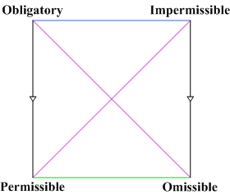

Description
Deontic Square

Slide 50
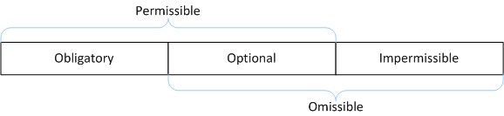
Description (contd)…
The Traditional Threefold Classification

Slide 51
Logical Grammar
Deontic Operators :
O φ : It is obligatory that φ.
P φ : It is permitted that φ.
Ғ φ : It is forbidden that φ.
Augmented Operators ^{[2]} :
OM φ : It is omissible that φ.
OP φ : It is optional that φ.

Slide 52
Logical Grammar (cont)..
Usual operators:
¬φ : It is not the case that φ.
(φ → Ψ) : If φ, then Ψ.
(φ ↔Ψ) : φ if, and only if Ψ.
(φ ∧ Ψ) : φ and Ψ.
(φ ∨ Ψ) : φ or Ψ.
Intuitively :
F φ ↔ ¬ P φ, F φ ↔O¬ φ, Pφ → ¬O¬φ.

Slide 53
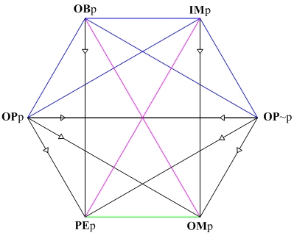
Deontic Square Revisited..
Deontic Hexagon ^{[4]}

Slide 54
Systems of Deontic Logic
Two main rules O and Modus Ponens.
1) If ˫φ , then ˫ Oφ . (O-rule)
2) If ˫φ and ˫ (φ→ Ψ) then ˫Ψ . (Modus Ponens)
˫ is read as “provable” .

Slide 55
DKr Logic
Minimal system deontic logic
consists of a single axiom for the distribution of O over a conditional.
Axiom 1: ˫φ if φ is tautology .
Axiom 2: ˫O(φ→ Ψ) → (Oφ → OΨ) .
Example:
If the case "It will rain today" is tautology then it is provable that it will rain today.
It is provable that if it is obligatory that “It will rain today" implies "I will miss the lecture" this implies that if it is obligatory that “It will rain today” implies that it is obligatory that "I will miss the lecture" .

Slide 56
DKr Logic (contd…)
DKr may lead to Good Samaritan Paradox :
If the good Samaritan helps Paul who has been robbed, then Paul has been robbed. (A tautology)
Φ:- the good Samaritan helps Paul who has been robbed
Ψ:- Paul has been robbed
So we have :
˫(φ → Ψ) then ˫O(φ → Ψ) (By O rule)
By rule 2 we have:
Oφ → OΨ

Slide 57
DKr Logic (contd…)
Assuming ˫φ(the good Samaritan helps Paul who has been robbed)
then by O rule have: ˫O φ
By modus ponens we get O(Ψ)
But clearly this conclusion is false; hence we have a contradiction.
We could replace axiom 2 by the weaker rule:
If ˫ φ → Ψ , then ˫ O φ → O Ψ .

Slide 58
D Logic
If a case is obligatory it is permissible also.
O φ →P φ.
Adding this axiom to DKr logic we get Standard D logic

Slide 59
DM Logic
Weaker counterpart of the Modal thesis ▫φ → φ is the claim it ought to be that what ought to be is the case, i.e., O(O φ → φ).
In other words, even though the real world is not ethically ideal, nevertheless it ought to be ideal.
All of the theorem of DKr is theorem of DM .
P(φ →Ψ)→(P φ →PΨ) not in DKr .

Slide 60
DBr Logic
According to Modal logic what is the case must be necessarily possible .
Expressed as O(φ →O(P φ)) .
Extension of DM logic
Consists more complex nested connection between deontic operators .

Slide 61
DS4 Logic
What is necessary must be necessarily necessary according to modal logic .
O φ →O(O φ) .
Consists of principle thesis of DM logic .
DS4.2:
Previously φ could be both obligatory and forbidden.
Prohibits PO φ ˄ PO ¬ φ .
Adds its negation as axiom.
PO φ → OP φ.

Slide 62
DS5 Logic
Again from modal logic what is possible must be necessarily possible.
P φ →OP φ .
All of the previous theorems provable .
Thought as a Supersystem .

Slide 63
Difference with Modal Logic
Modal Logic:
Extends formal logic .
Includes modality (necessary and possible) .
Qualify truth of judgement .
If “John is happy” is true we can say “john is very happy” .
Very is modality here .

Slide 64
Examples
It is necessary that it will rain today if and only if it is not possible that it will not rain today .
It is possible that it will rain today if and only if it is not necessary that it will not rain today.
Similarly can be expressed in deontic logic .
It is obligatory that it will rain today if and only if it is not permissible that it will not rain today .
It is permissible that it will rain today if and only if it is not obligatory that it will not rain today .

Slide 65
Deontic Logic World
What is Ideal World?
Might not be perfect in general sense .
Conditional obligation O(P|S) .
Study of logial relations in deontically logical world.
Model is ordered triple, <G, R, ⊨>.

Slide 66
Deontic Logic World (contd…)
w ⊨ ¬ P if and only if w ⊭P .
w ⊨ (P & Q) if and only if w ⊨ P and w ⊨ Q .
w ⊨ OP if and only if for every element v of G, if w R v then v ⊨ P
w ⊨ P P if and only if for some element v of G, it holds that w R v and v ⊨ P .
S5 is the strongest logic as R is reflexive ,symmetric and transitive i.e. , equivalence relation .

Slide 67
Limitations
How to properly represent conditional obligatories?
If you smoke(s) Then you ought to use an ashtray (a).
Two representations:
O(s→a) .
s→O(a) .
No representation is adequate .
Dyadic Deontic logic. Contains binary deontic operators .
O(A|B): It is obligatory that A, given B.
P(A|B) : It is permissible that A, given B.

Slide 68
Why Deontic Logic?
Standard logic is not clear if norms has no truth values.
It is not clear how a norm logically follows other norms, conjunction between them.
Explained by semantic theory of possible worlds.
Deontic operators have the same logical properties under a descriptive as under a prescriptive interpretation.
Deployable in legal and moral issues.

